Slide 1
Tables and Matrices
Tables and Matrices

Slide 2
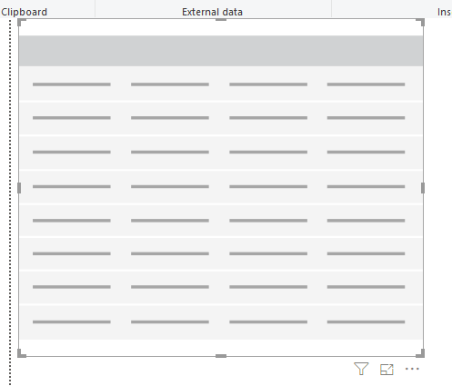
Tables and Matrices
Add a table visualization to the scene

Slide 3
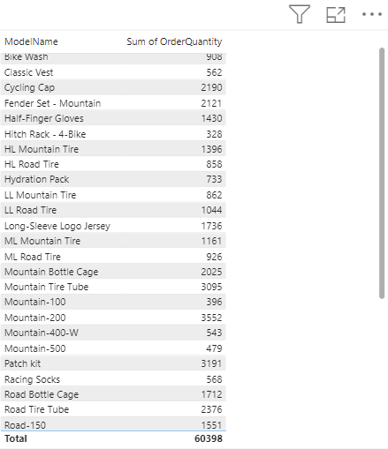
Tables and Matrices
Add the two ModelName fields from DimProduct and OrderQuantity from FactInternetSales and observe the values represented at the table level
Click the small rectangle next to each column header to change the sort order.

Slide 4
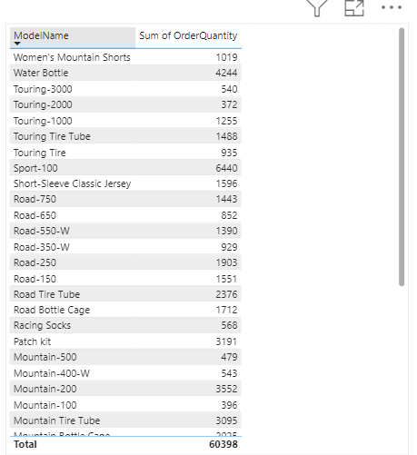
Tables and Matrices
Click the small rectangle next to each column header to change the sort order.

Slide 5
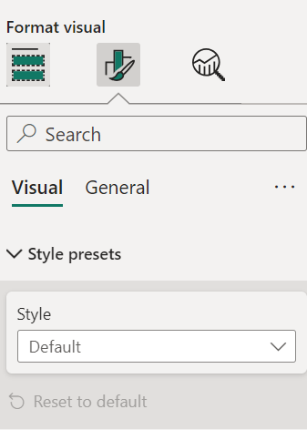
Tables and Matrices
In the Format section, change the Style setting to Bold Heading

Slide 6
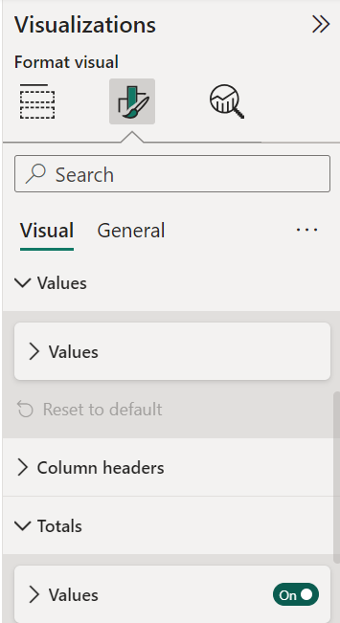
Tables and Matrices
Still at the Format level, try to enable/disable the value of the Totals parameter

Slide 7
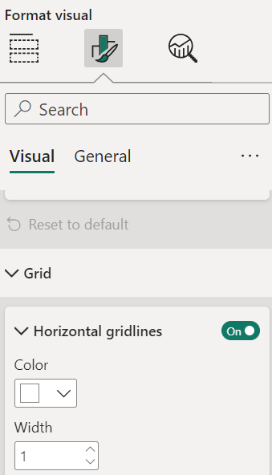
Tables and Matrices
Try changing the value of the Grid parameter

Slide 8
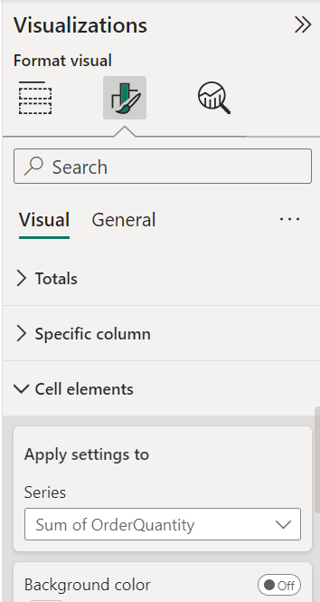
Tables and Matrices
Still in the Formatting section , try to go to the Cell Elements section and select OrderQuantity
1
2
3

Slide 9
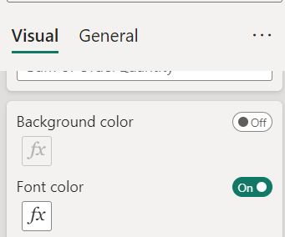
Tables and Matrices
Enable FontColor

Slide 10
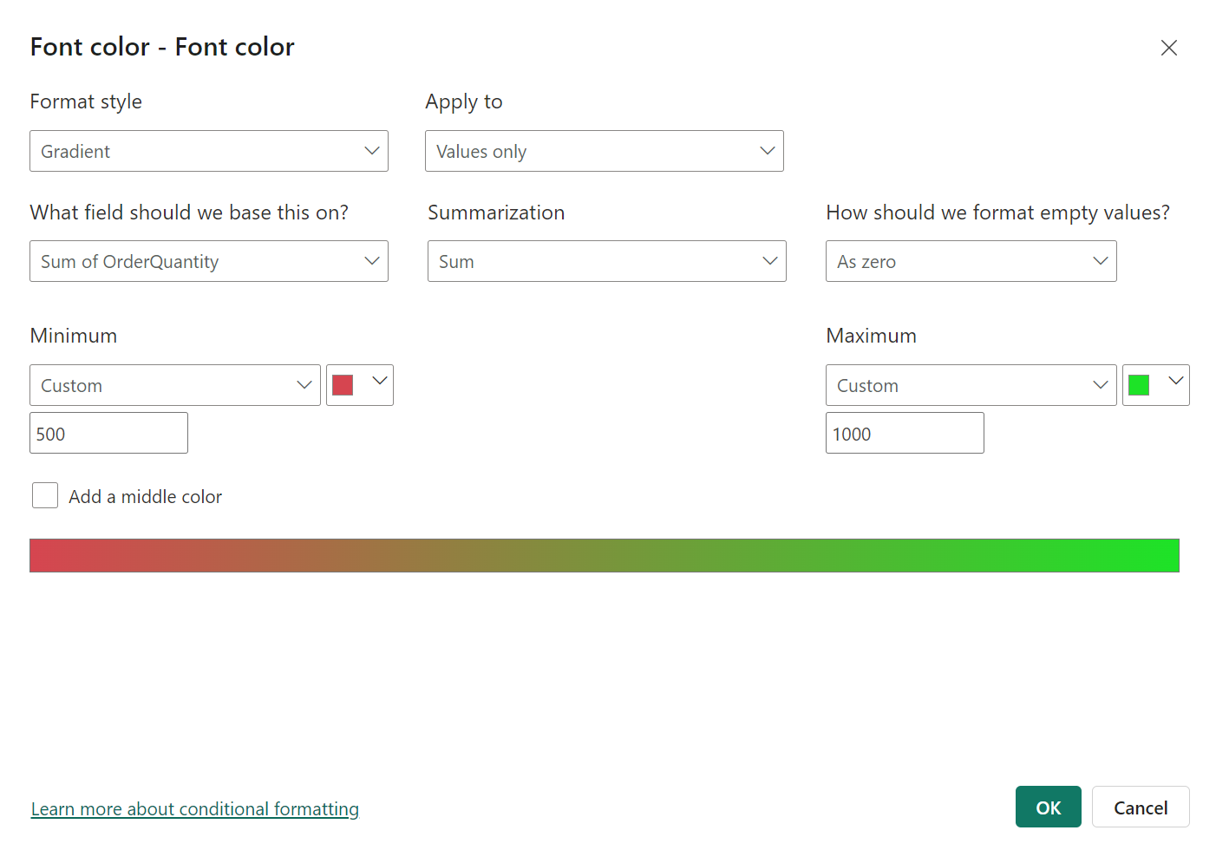
Tables and Matrices
Then configure conditional formatting based on the

Slide 11
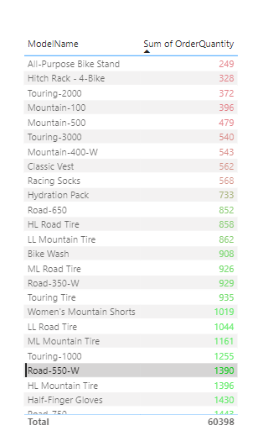
Tables and Matrices
Observe the result

Slide 12
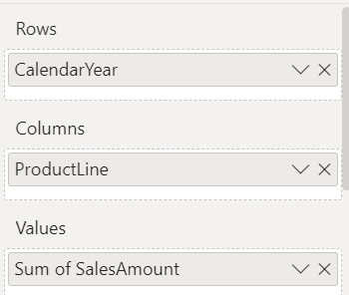
Tables and Matrices
Table visualization with Matrix Visualization
Configure it according to the table
Setting | Field
Lines | Calendar year
Columns | Product range
Values | Sales amount

Slide 13
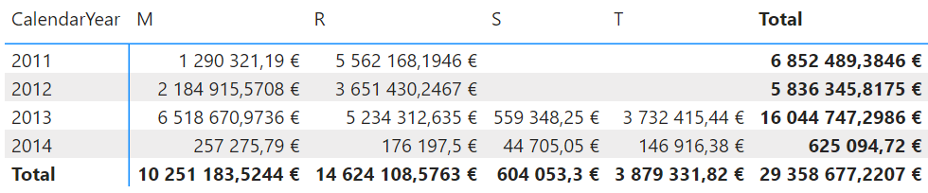
Tables and Matrices
Observe the matrix

Slide 14
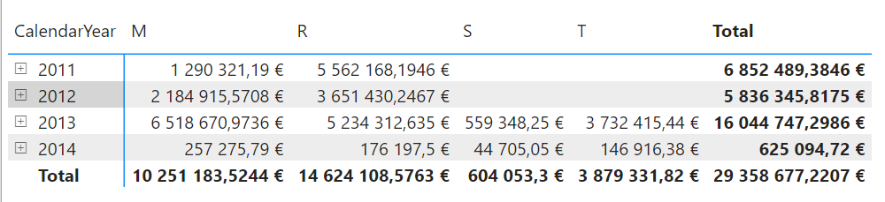
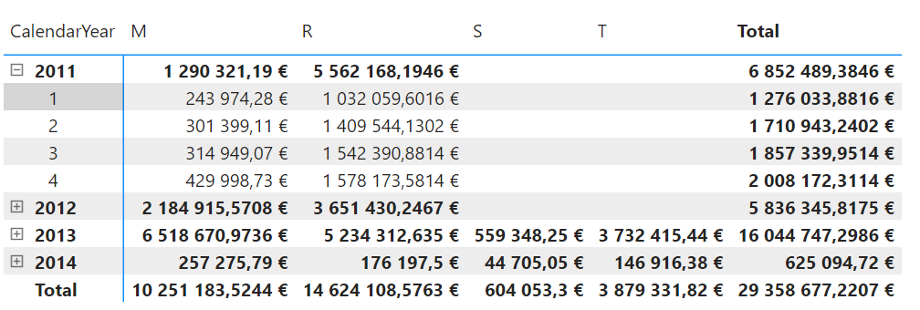
Tables and Matrices
Add CalendarMonths on lines level in addition to the calendar year and note the sign
Try to enlarge the view by clicking on the sign

Slide 15
Tables and Matrices
In the Format section, try typing Subtotals , then try turning subtotals on/off at the row and/or column level

Slide 16
Thank you
Thank you

